Slide 1
Getting started with cs-studio:

Slide 2
Running CS-Studio
Running cs-studio from command line
train@training:~/cs-studio$ ./cs-studio-with-pref
Notes:
NSLS2

Slide 3
Running CS-Studio
You can also install cs-studio yourself by downloading and unzipping the appropriate .zip file from
http://controlsystemstudio.org/download.html
~$: ./cs-studio
There are multiple versions of the cs-studio product. Customized for different sites and use cases
Notes:
NSLS2

Slide 4
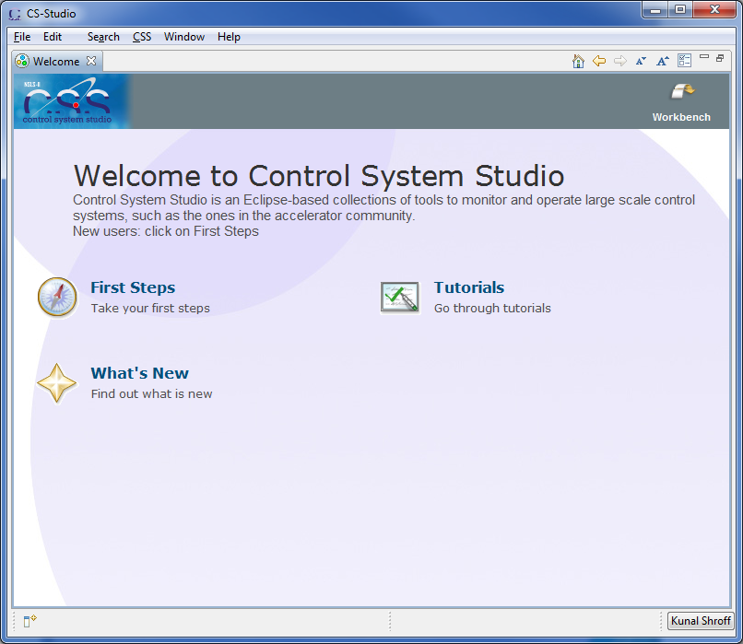
Welcome
First Steps
Tutorials
What’s New
Help → Welcome

Slide 5
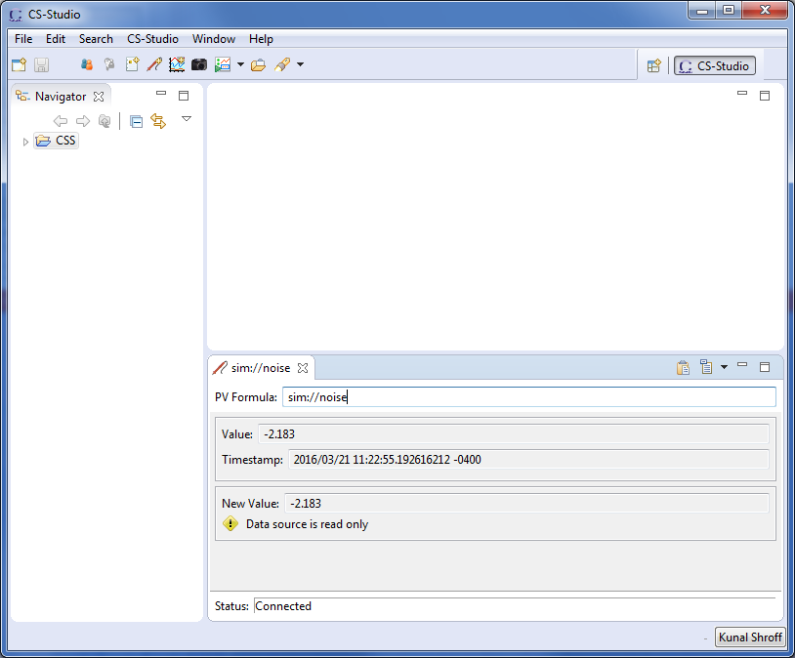
Workbench
It represents your working environment.
Window
Menu bar
Toolbar
Perspective bar
Views

Slide 6
CS-Studio: Probe

Slide 7


Probe
A simple application to connect to pv’s
Monitor pv’s (caget, camonitor)
Write to pv’s (caput)
Opening probe
Menu: CSS → Diagnostic Tools → Probe
Toolbar:
Context Menu*: Process Variable → Probe

Slide 8
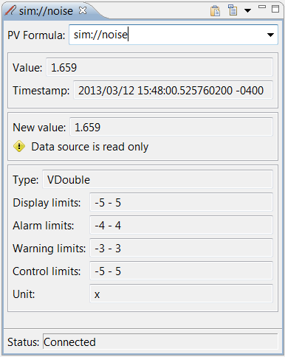
Probe - getting started
Connect to a simple scalar pv (simulation)
In the PV Formula field type “sim://noise” and hit the return key
Connect to a simple scalar pv (IOC)*
In the PV Formula field type “XF:31IDA-OP{Tbl-Ax:X1}Mtr.RBV” and hit the return key
* Start the test IOC
>> cd /home/train/git/build-epics/motorsim >> ./startSimMotor.sh
Notes:
TODO: pv name

Slide 9
Probe - deciphering the data
Value:
Shows the current value of the pv and the timestamp associated with it
Change Value:
The new value field is used to write new values to the pv If the pv is read only this field is disabled
MetaData:
Additional information about the pv Type, Display limits, Alarm limits, units…..

Slide 10
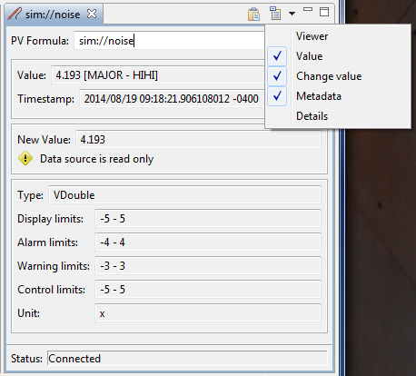
Probe - deciphering the data
The drop down menu allows you to selected the additional information about the pv and the connection to be displayed
Viewer
Value
Change value
Details

Slide 11
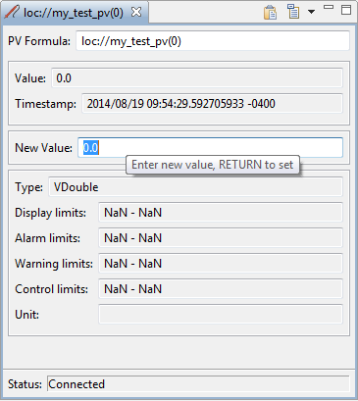
Probe - writing a value
Connect to a simple scalar pv (local)
In the PV Formula: field type “loc://my_test_pv(0)” and hit RETURN
In the New Value: field enter any valid number and hit RETURN

Slide 12
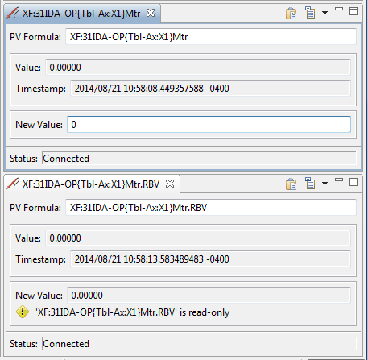
Probe - writing a value
Open 2 probes
Move the probe views so that they can be both viewed simultaneously
In the first probe enter the setpoint pv PV: XF:31IDA-OP{Tbl-Ax:X1}Mtr
In the second probe enter the Readback pv PV: XF:31IDA-OP{Tbl-Ax:X1}Mtr.RBV
Set a new motor position (-100 and 100)

Slide 13
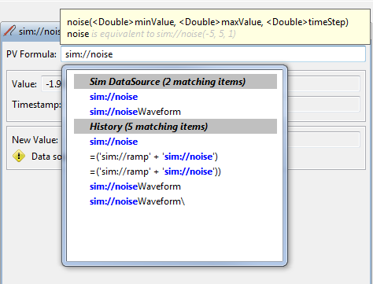
Probe - Autocomplete
Autocomplete
History
ChannelFinder
Predefined simulation pv’s (Datasources)
Formula functions
Notes:
TODO: add autocomplete for softIOC pv

Slide 14

Probe - Help
Help → Help Content
CSS Applications → Diagnostic Tools → Probe

Slide 15
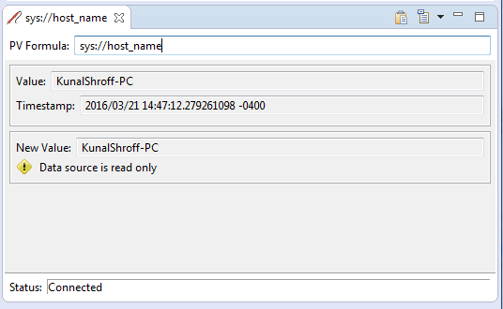
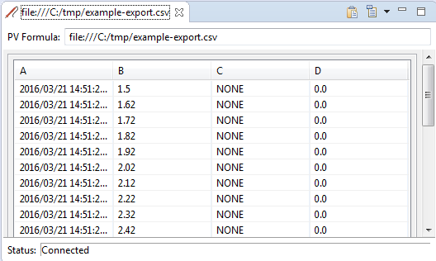
Probe – process variable (Datasource)
type://some_pv_name
Datasources
System (sys://)
Local (loc://)
Simulation (sim://)
File(file://)
PVAccess (pva://)
Help
CSS Core → Process Variables

Slide 16
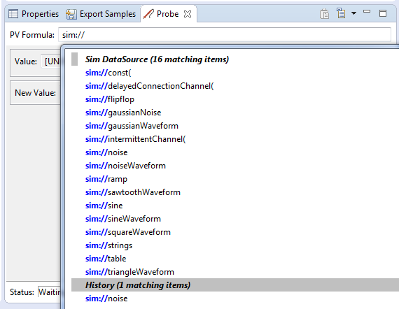
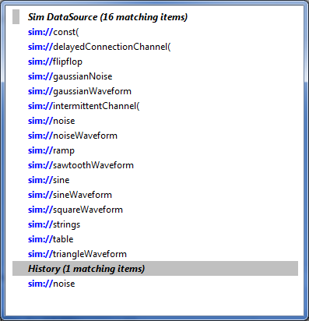
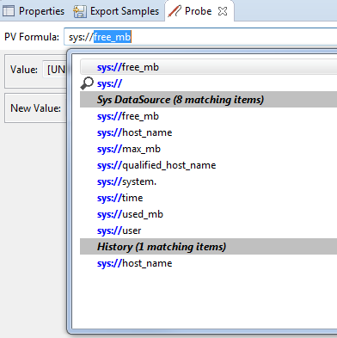
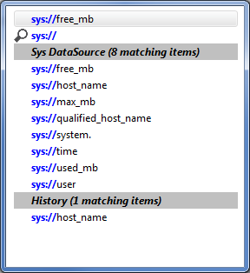
Probe - Autocomplete Datasources
Autocomplete will list the various pv’s available for a particular datasource
Figure 1

Slide 17
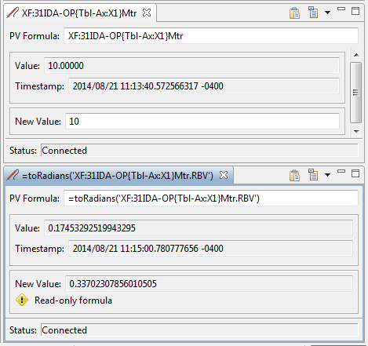
Probe - pv’s and formulas
Formulas
Mathematical operations
Logical operations
Array operations
Create/modify tables and arrays
Start with a ‘=‘
Don’t use formulas for things that should be done in the IOC

Slide 18
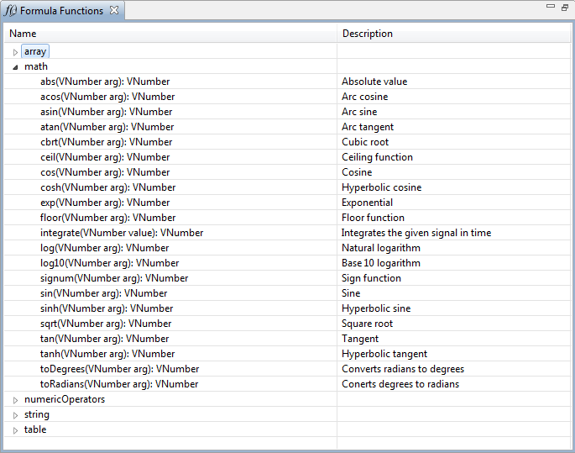
Probe - pv’s and formulas
CSS →
Debugging →
Formula Functions

Slide 19
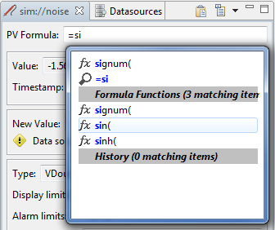

Probe - Autocomplete formula
Figure 1: Autocomplete will list the formula functions matching your text.
Figure 2: Autocomplete will help you fill the formula function with the correct parameters.
Figure 1
Figure 2

Slide 20
CS-Studio and PVAccess

Slide 21
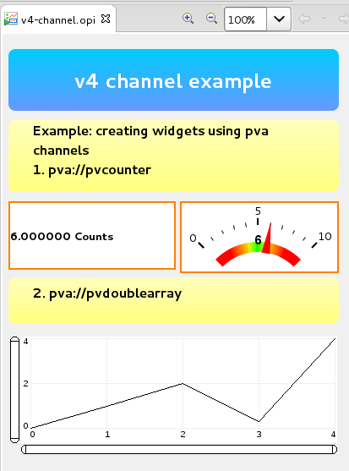
Creating EPICS7 channels pva datasource
The pvaccess datasource prefix when creating the channel pva://<name>

Slide 22
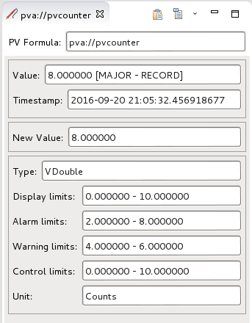
Creating EPICS7 channels pva datasource
Use the pvacess datasource prefix when creating the channel pva://pvcounter epics:nt/NTScalar:1.0 -> Vdouble

Slide 23
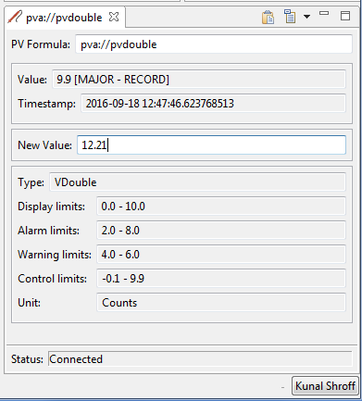
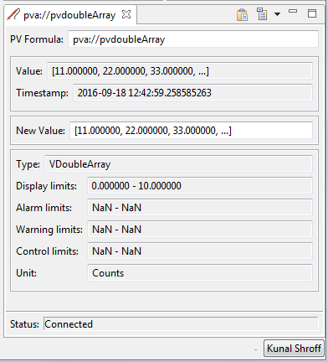
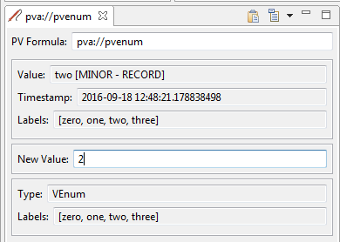
Accessing EPICS7 structured data
The pva module provides the mapping for NTTypes to Vtypes
Currently supported NTTypes includes
General Normative Types
NTScalar
NTScalarArray
NTEnum
NTTable
Specific Normative Types
NTMultiChannel
NTNDArray

Slide 24

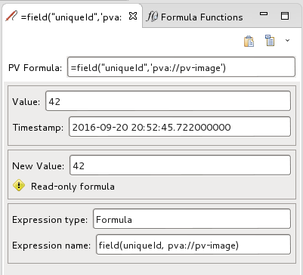
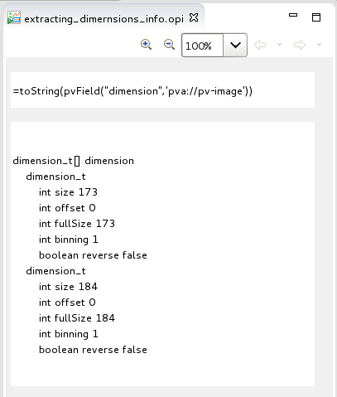
Accessing EPICS7 structured data
Formula Functions Allow parsing of any EPICS7 data structure into a Type that can be used by cs-studio applications

Slide 25

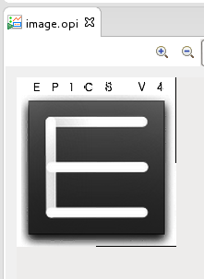
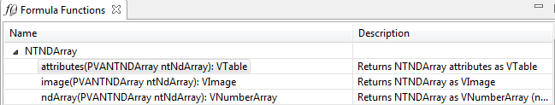
Accessing EPICS7 structured data
NTNDArray formula set
image
Creates an VImage from the NTNDArray using all the appropriate fields (value, dimensions, …)
ndArray
Extracts the raw values as a VNumberArray
attributes
Creates a VTable from the attributes structure of this NTNDArray

